Slide 1



Artificial intelligence
as the future for digitalization
in the quality assurance of the medicinal products.
SPEAKER: MAKLAKOVA OLGA

Slide 2

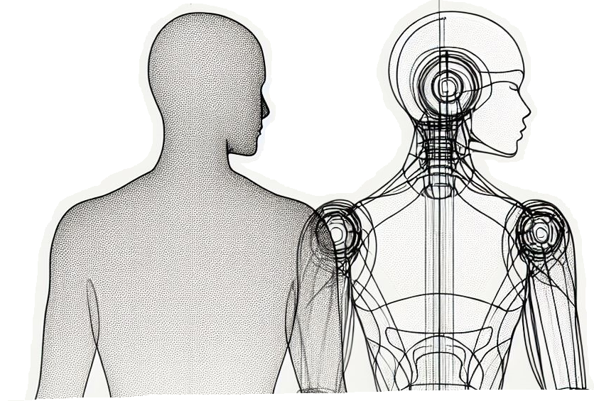
AI is the future assistant for QA.
The topic of digitalization of pharmaceutical production has been studied quite well, and we cannot imagine modern production without the use of computerized systems and their validation.
We are increasingly reading news about companies using machine learning algorithms to develop new medicines but can we imagine our future and the use of AI in production and quality assurance for a moment?
Can we look into the future and imagine a scenario where AI is the best at quality assurance?

Slide 3
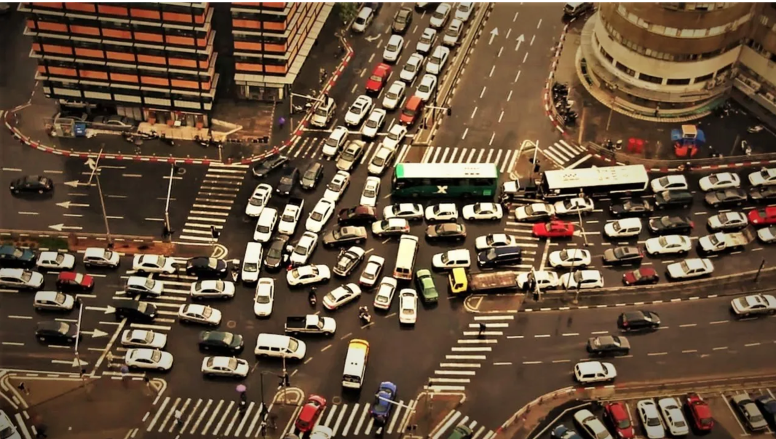

AI is the best assistant in the handling and transformation of data.
WHY DATA IS SO IMPORTANT?

Slide 4
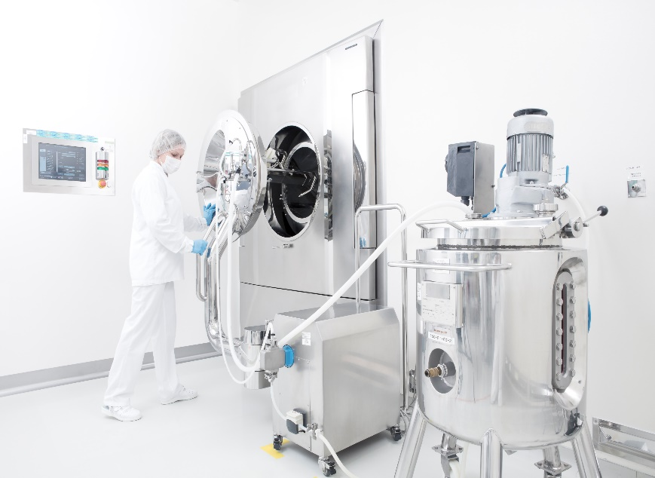



AI-huge support for GMP.
With a digitalized report containing all data from manufacturing, testing and statistical systems, AI can quickly analyze any trends visible on testing or manufacturing parameters. Moreover it can quickly summarize the whole report and provide any needed graphs, making it possible to „talk” to the lengthy report.
It is also possible to create an AI agent for specific tasks related to validation, for example, an AI agent created specifically for QPs that will summarize the data according to the same parameters.
Use of AI to analyze trends, quickly summarize the results and create graphs
Use of AI agents is our future

Slide 5
AI in the validation.
Validation of the future can be automated by migration of data from the primary source of data
MES BATCH REPORTS (CPP)
MAXIMO (MAINTENANCE RECORDS)
IN-PROCESS RECORDS (CQA)
Commercially available Paperless Validation systems can be used to digitize validation. With them, there is a possibility to create electronic validation protocols in which you can mark the appropriate locations for data collection through an interface with production, laboratory and statistical systems.
By defining acceptance criteria in the protocol, the Paperless Validation system can perform validation of the collected data. This will allow automatic evaluation of the correctness of the conduct of the production process and the quality of the product.
LIMS QC RECORDS
(PHARMACOPOEA)
PAPERLESS VALIDATION SYSTEM
AUTOMATED VALIDATION REPORT
PRODUCT QUALITY REVIEWS
RESULTS FOR TRENDING
BATCH RELEASE
Digitalizing test results and automating validation activities increases data integrity

Slide 6

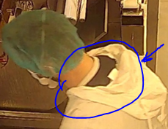
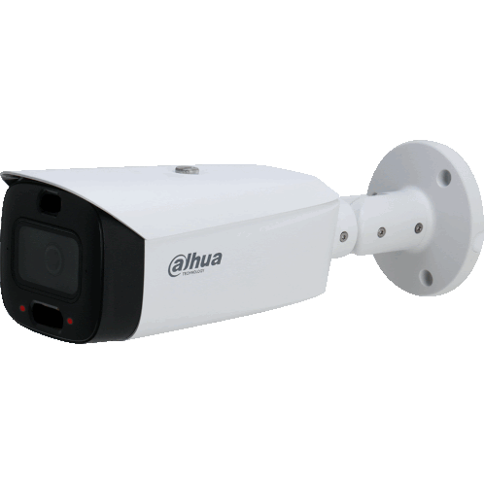
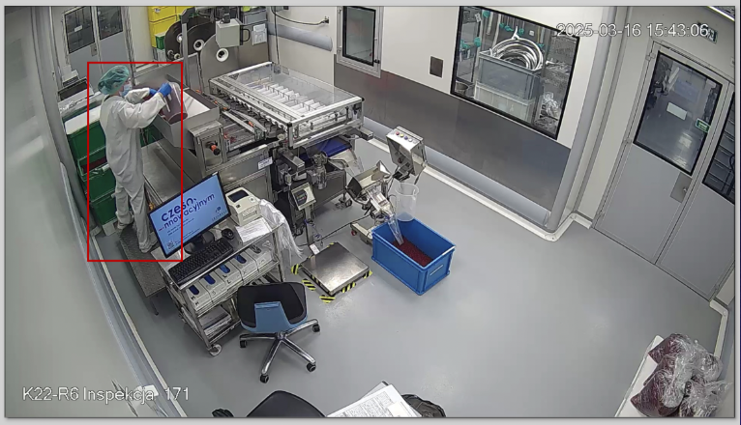

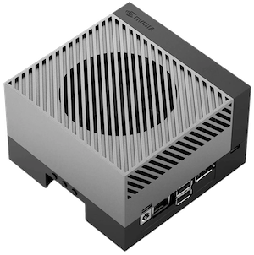


AI and personnel violations.
  AI-powered visual inspection solution that detects potential violations such as missing masks or gloves, rolled-up sleeves, or improper use of mobile phones. It sends real-time alerts to supervisors for human verification and action.
  Training material is a critical resource for any machine learning project
The system works in such a way that it detects the presence of people (individuals) in the room. If a person is identified in the frame, the frame is sent to the cloud for analysis of cases using LLM / ML. In the event of an AI suspicion of an incident in a photo, it is recorded in the database, from which, every quarter of an hour, the system collects the latest incidents and attaches a notification to the email.

Slide 7

AI of IO architecture.
IO DIGITAL TRANSFORMATION
Optimize manufacturing domain by harnessing data and automation for real-time, cost-efficient manufacturing & decision-making
Proceses
Data analytics and AI tools
Digital automation
Moving from paper
Data analysis
Data Architecture
Legacy systems & assets analysis and modernization
Data driven decision making
Systems Architecture
Cloud or hybrid-based solutions and infrastructure
Data integration and management
Predictive Analytics
Real-time data collection and monitoring
Connectivity
Machine learning
Automatic workflows
Change management and training programs
Artificial Intelligence
Robotic Process Automation (RPA)
Inspire & Motivate
Transparency & communication
People & interactions
Engage
Project colaboration
Responding to changes
Build digital competencies
Responsibility & data driven
decision making
Measurable KPIs & effects
People
Culture
Agile

Slide 8

Find the right place for you
Where tradition meets future

